Slide 1

Week 6
Data analysis
Fundamentals of IoT
Dr. Eoin Rogers (eoin.rogers@tudublin.ie)

Slide 2
Lesson Outline
This will be a basic introduction to data analysis: what is it and why is it useful
We will cover both NumPy and Pandas, two Python libraries widely used for data analysis
We will also talk briefly about common statistical models

Slide 3
What is data analysis?
Modern systems often produce significant quantities of data
This is particularly true for IoT!
This data can be analysed to discover patterns and useful information
This might be good for informed decision making

Slide 4
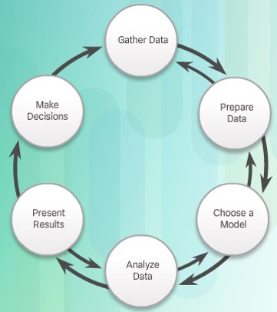
Six step analysis lifecycle
Notice that there is a vague similarity to the scientific method: we’re trying to gather data and then build models that explain that data.

Slide 5
Big data
IoT systems can be a significant source of big data. This can be useful for:
  Decision making
  Machine learning
  Improving IoT systems
But it also means we have to be mindful of ethical issues!

Slide 6
Terminology
There are some important pieces of terminology we should keep in mind

Slide 7
Data analysis can be:
Descriptive – We might just want to know what happened
Predicitive – We might want to build models to predict what will happen or to fill in gaps in the data
Prescriptive – We might want to use the data to inform decision making and help us choose between alternatives

Slide 8
The four big Vs of data
Volume – The quantity of data
Velocity – The frequency of the data
Variety – The unpredictability of data
Veracity – The accuracy of the data

Slide 9
States of data
Data can be
  In motion – i.e. being transmitted over the network
  At rest – i.e. being stored on a disk
  In use – i.e. being processed

Slide 10
NumPy
Let’s look at some actual code!

Slide 11
ndarray
The core class of NumPy – an n-dimensional array
Similar to a Python list, but much more powerful
Although everything in the array must have the same type, and the dimensions along each axis must be uniform

Slide 12
Attributes of ndarray
ndim
shape
size
dtype
itemsize

Slide 13
Creating an ndarray
Use array() to create a Python list:
import numpy as np
my_array = np.array([[1, 2, 3],
[4, 5, 6]])

Slide 14
Creating an ndarray
Or create an array of all zeros:
import numpy as np
my_array = np.zeros(shape=(3, 3))

Slide 15
Creating an ndarray
Or of all ones:
import numpy as np
my_array = np.ones(shape=(3, 3))

Slide 16
Creating an ndarray
Use arange() to create an array containing a range:
import numpy as np
zero_to_nine = np.arange(10)
two_to_nine = np.arange(2, 10)
zero_to_nine_even = np.arange(0, 10, 2)

Slide 17
Creating an ndarray
Use linspace() to create an array containing evenly spaced numbers:
import numpy as np
twelve_numbers = np.linspace(0, 10, 12)
(Note this includes the 10)

Slide 18
Reshaping an array
four_by_three = twelve_numbers.reshape(4, 3)

Slide 19
Elementwise maths operations
If x and y are ndarrays of the same shape:
x + y
x – y
x * y # N.B. This isn’t matrix
# multiplication!

Slide 20
Matrix multiplication
Use the @ symbol for matrix multiplication:
x @ y

Slide 21
Array indexing and slicing
Very similar to how it works in Python:
a[0], a[-2], a[1:5]
a[1:5:2], a[1:], a[:5]
a[::2], a[::-1]

Slide 22
Array indexing and slicing
But we can seperate dimensions by commas:
a[0, 5], a[1:3, 5]
a[::2, 3], a[1::2, 2:8]

Slide 23
Three useful methods
Use ravel() to flatten arrays
Use vstack() to stack arrays vertically
Use hstack() to stack arrays horizontally

Slide 24

Pandas
This is another Python library widely used for data analysis

Slide 25
DataFrames
The DataFrame is the core data structure used in Pandas
  You can think of it as a cross between a NumPy array and a database table
  Consists of rows of data each of which follows a schema specified in a columnar format

Slide 26
Creating a DataFrame
import pandas as pd
students = pd.DataFrame({
'Name': ['John', 'Mary', 'Bob', 'Anne'],
'Subject': ['Computer Science', 'Physics',
'History', 'Business'],
'Average exam result': [70, 80, 65, 85],
})

Slide 27
Creating a DataFrame
import pandas as pd
students = pd.read_csv('students.csv')

Slide 28
Useful DataFrame methods and attributes
head()
tail()
index
columns
to_numpy()
describe()
T
sort_index()
sort_values(by='name')

Slide 29
Access a column by name
students['Name']

Slide 30
Access a column by index (primary key)
students.loc[0]

Slide 31
Filter a row by column
students.loc[0, ['Name', 'Subject']]

Slide 32
DataFrames support slicing!
students.loc[0:2, ['Name', 'Subject']]

Slide 33
Boolean indexing (like an SQL query)
students[
students['Average exam result'] >= 80
]

Slide 34
Data analysis techniques
This will be the last topic!

Slide 35
Important terms
Averages
  Mean
  Median
  Mode
Standard deviation
Percentiles

Slide 36
Dimensionality reduction
Given a high-dimensional input, reduce it to low-dimensional data while minimising the amount of information that is lost
Examples:
  Linear discriminant analysis
  Principle component analysis
  Autoencoders
  Information gain

Slide 37
Statistical correlation analysis
A mathematical measure of the similarity between two variables
  In other words, given that you know the value of variable A, how accurately can you predict the value of B?
One measure in common use if Pearson correlation

Slide 38
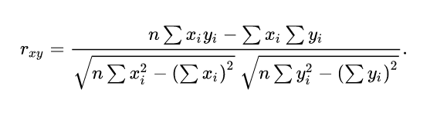
Pearson correlation
x and y are the two datasets, both of length n, and we use i as an index name

Slide 39
Summary
IoT devices produce huge quantities of data, so it can be useful to know some basic data analysis techniques to deal with them
Terminology like the four big Vs or data in motion/rest/use are important, even if they seem trivial
Pandas and NumPy are the workhorse of the data analysis world
Statistical and machine learning terms are important as well

Slide 40
25
That’s all for this week
Thanks for your attention!

